Slide 1
Empirical Minimum Bayes Risk Prediction: How to extract an extra few % performance from vision models with just three more parameters
Vittal Premachandran
NTU/NUS
Daniel Tarlow
Microsoft Research
Dhruv Batra
Virginia Tech

Slide 2
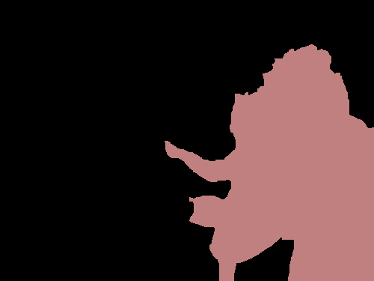
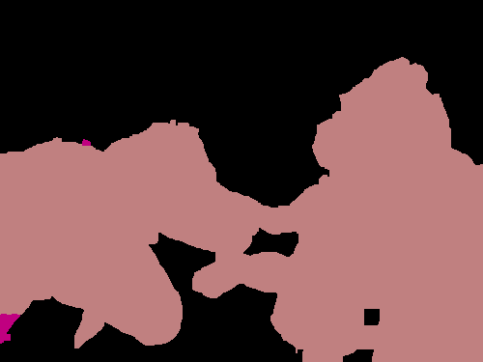
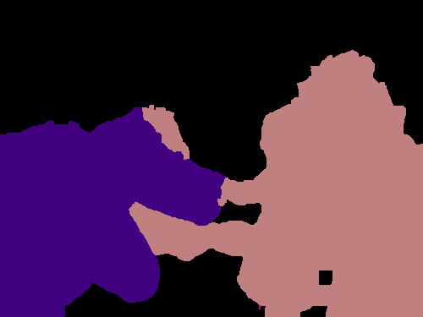
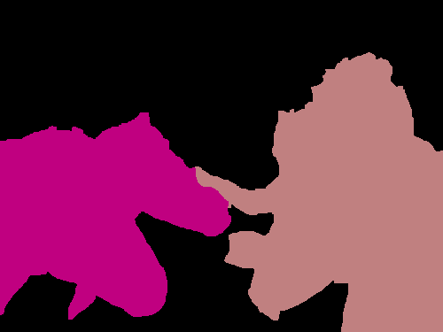
Game
Input Image
Black Box
0.406
0.398
0.359
0.334
person
person
dog
person
horse
person

Slide 3
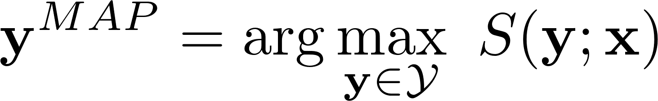
MAP

Slide 4
MAP is not always accurate!

Slide 5


Slide 6
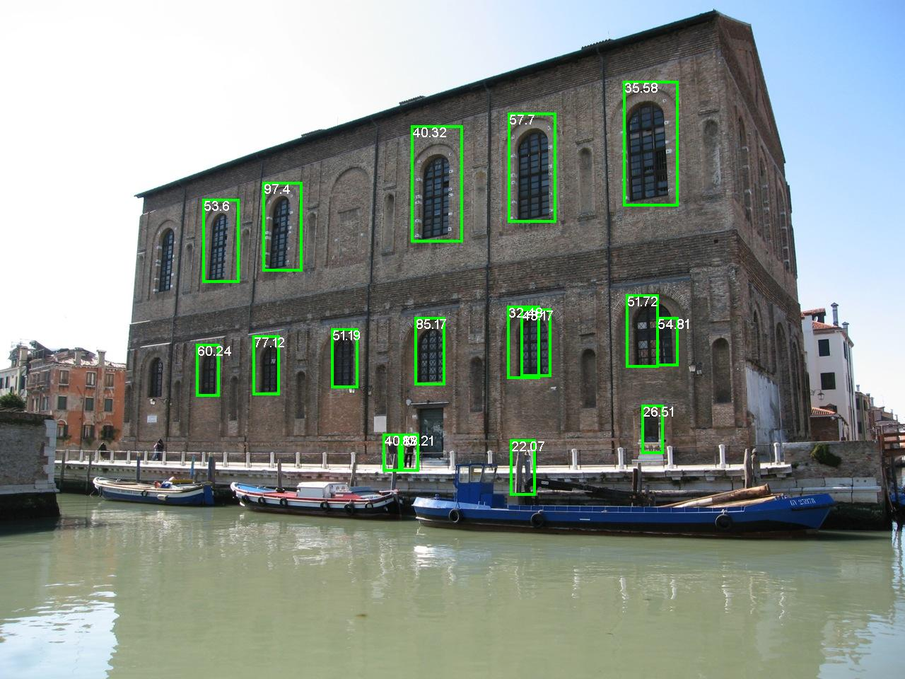

Slide 7


Slide 8
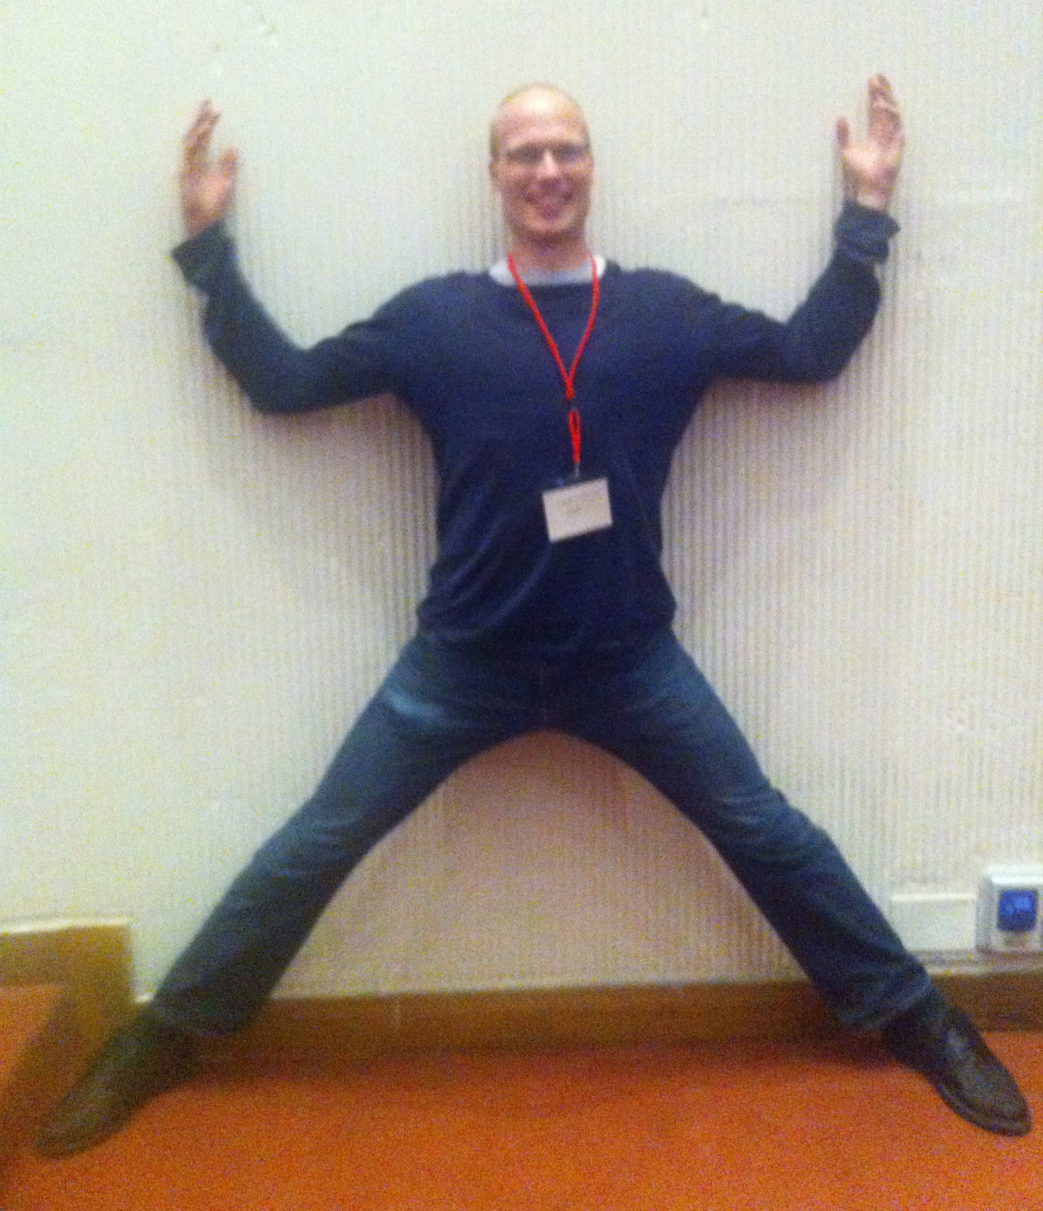
Problems
Model-Class is Wrong!
-- Approximation Error
Human Body ≠ Tree
Figure Courtesy: [Yang & Ramanan ICCV ‘11]

Slide 9
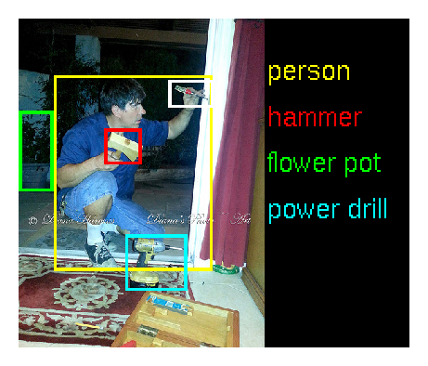
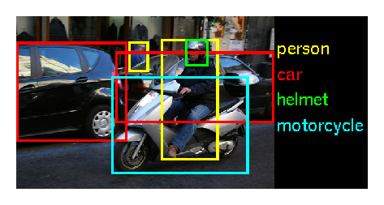
Problems
Model-Class is Wrong!
Not Enough Training Data!
-- Approximation Error
-- Estimation Error

Slide 10
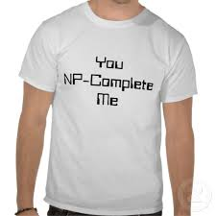
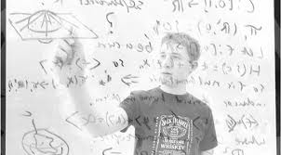
Problems
Model-Class is Wrong!
Not Enough Training Data!
MAP is NP-Hard
-- Approximation Error
-- Estimation Error
-- Optimization Error

Slide 11
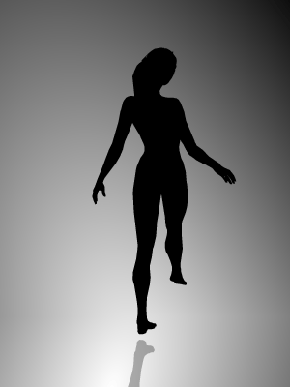
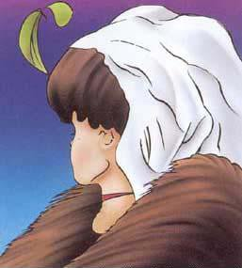
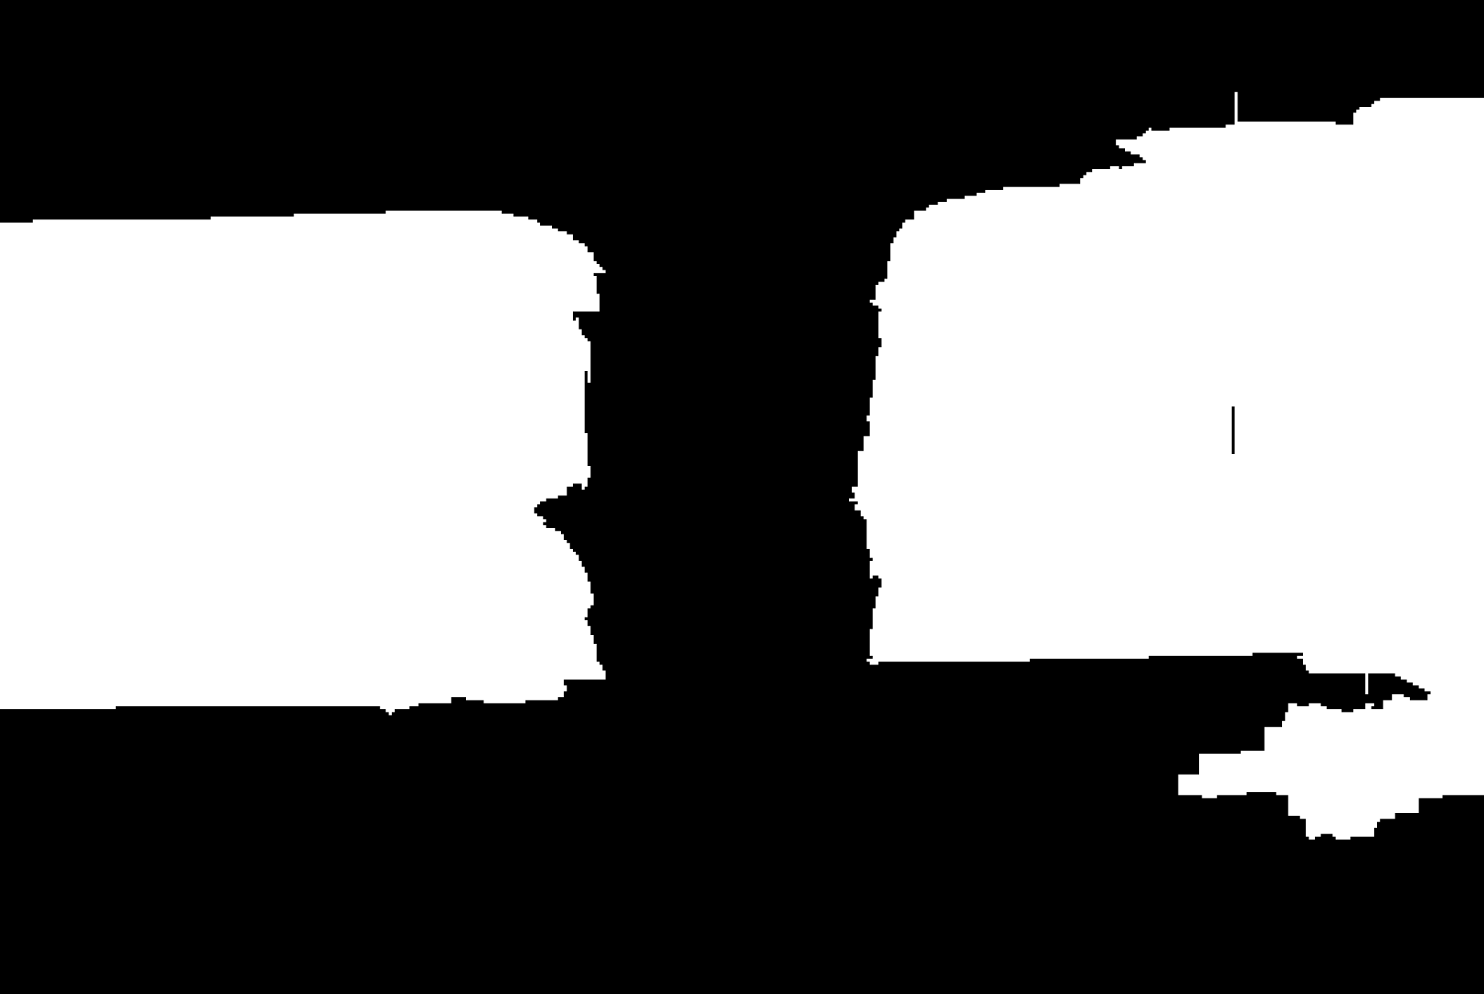
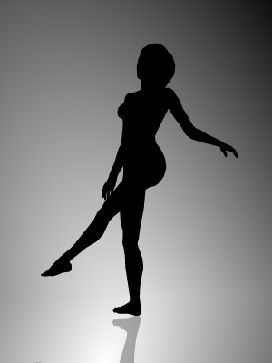
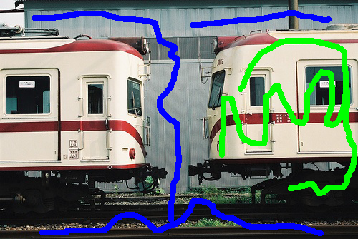
Biggest Problem
Model-Class is Wrong!
Not Enough Training Data!
MAP is NP-Hard
Inherent Ambiguity
-- Approximation Error
-- Estimation Error
-- Optimization Error
-- Bayes Error
?
?
Rotating clockwise / anti-clockwise?
Old Lady looking left / Young woman looking away?
One instance / Two instances?

Slide 12
Empirical Minimum Bayes Risk Prediction

Slide 13
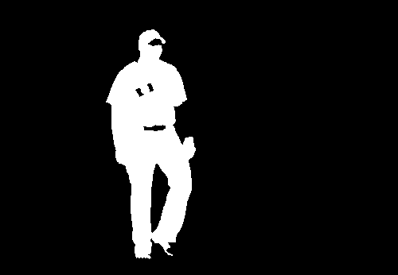
Statistics 101
Loss
Hamming, Pascal, …
“True” Distribution
Expected Loss:
Min Bayes Risk
Fit model (CRF, etc) to mimic

Slide 14
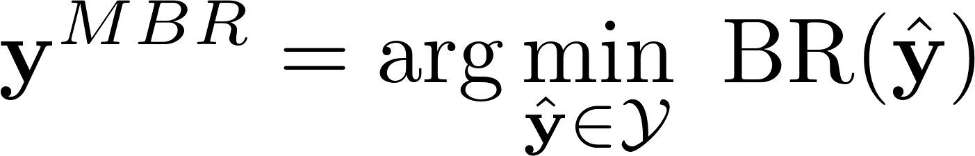
Comparison
MAP
MBR

Slide 15
Issues with MBR
Min Bayes Risk
Two Problems
Intractable
Intractable
Doubly Intractable!

Slide 16
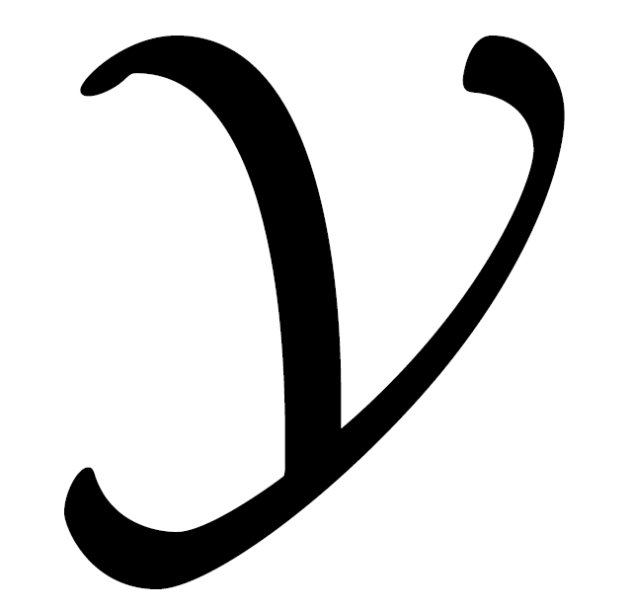

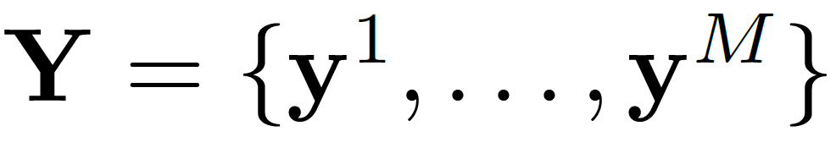
Empirical MBR
Replace
Intractable
Tractable
DivMBest [Batra et al. ECCV ‘12]

Slide 17
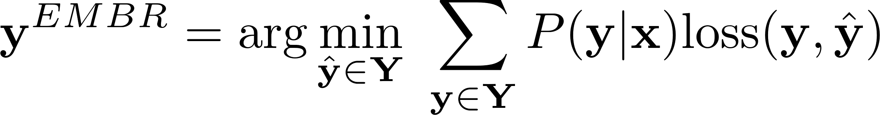
Comparison
MAP
MBR
Empirical Minimum Bayes Risk Predictor

Slide 18
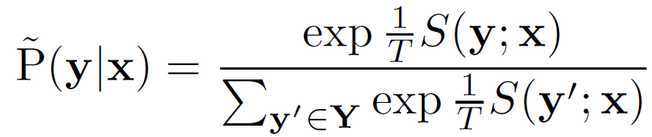
Scores to Probabilities
Assume access to a scoring function
Minimal assumptions on how it is constructed
Calibrate scores into meaningful probabilities

Slide 19
Three Parameters
T
Temperature Parameter
λ
Diversity Parameter
M
# Diverse Solutions

Slide 20
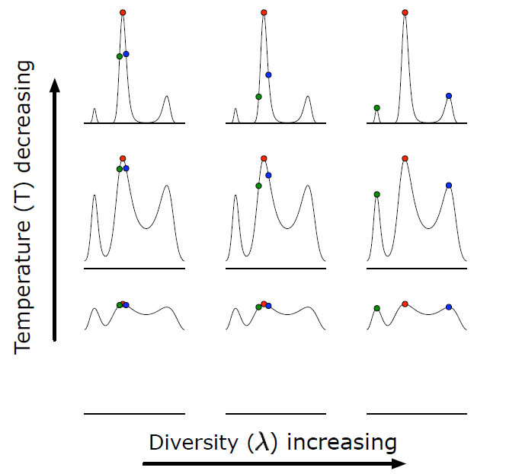
Illustration

Slide 21
Parameter Tuning
Grid Search
Tune on a validation set
Use a meaningful loss function to tune the parameters

Slide 22
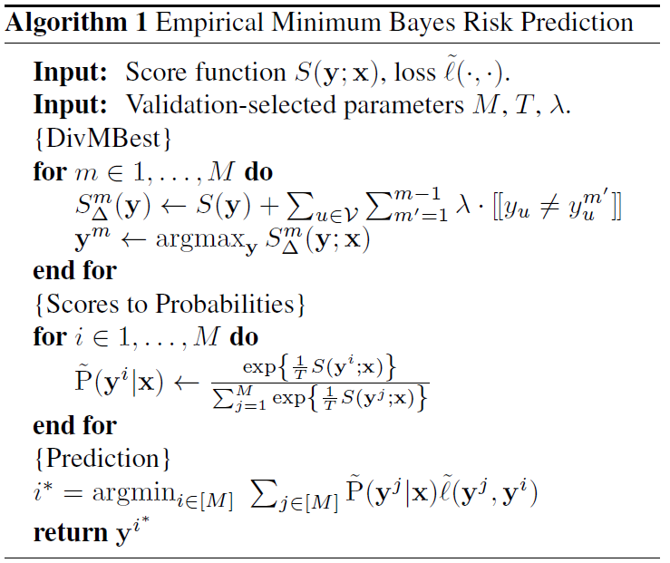
Algorithm

Slide 23
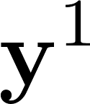
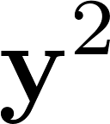
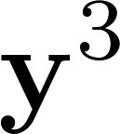
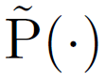
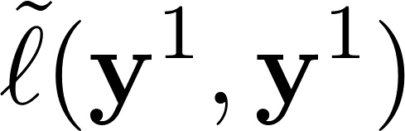
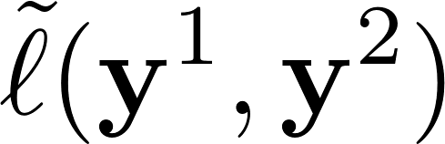
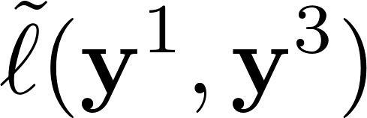
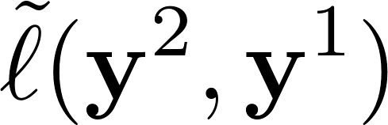
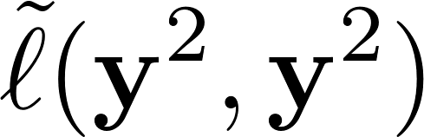

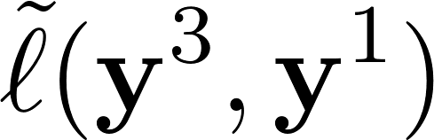

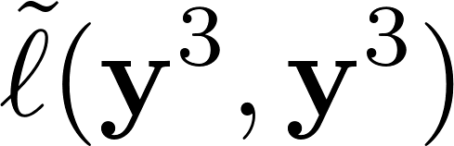
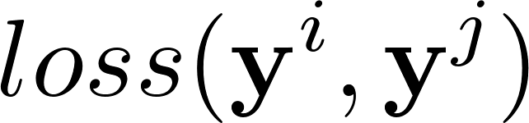
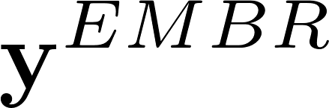
Simple to compute
0.406
0.359
0.334
person
dog
person
horse
person
person
dog
person
horse
person
0.406
0.479
person
person
person
dog
0.359
0.268
person
dog
person
dog
person
horse
person
0.334
0.205
horse
person
horse
person
0.479
0.268
0.205
person
dog
person
horse
person

Slide 24
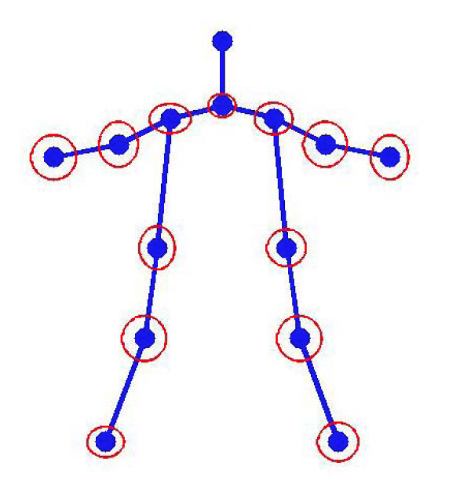
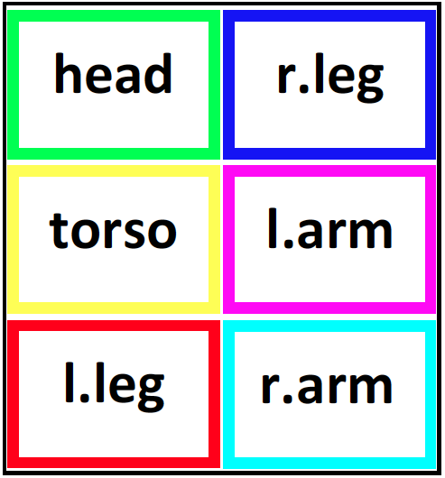
Experiments: Pose Estimation
Setup
Model: Mixture of Parts Tree [Park & Ramanan, ICCV ‘11]
Inference: Dynamic Programming
Dataset: PARSE
Loss Function: Percentage of Correct Parts
Image Credit: [Yang & Ramanan, ICCV ‘11]

Slide 25
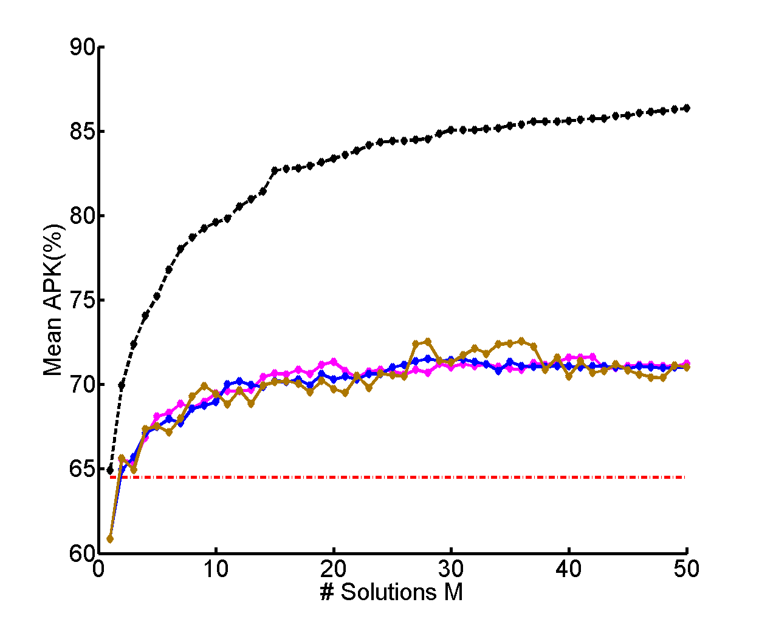
Pose Estimation
Oracle
~7% Gain
Same Model No new information!
22%-gain possible
Same Features Same Model
State of art
[Yang & Ramanan PAMI]

Slide 26
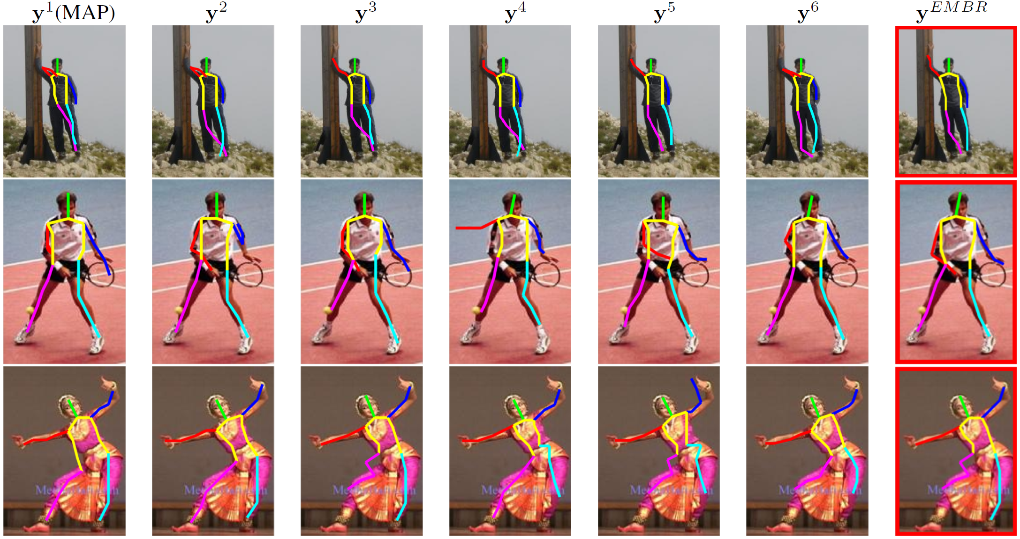
Qualitative Results

Slide 27
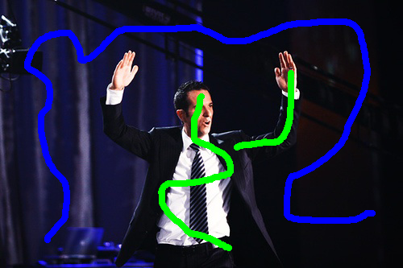

Interactive Binary Segmentation
Setup
Model: 2-Label pairwise CRF
Inference: Graph Cuts
Dataset: PASCAL VOC 2010 (100 images)
Loss Function: Intersection over Union

Slide 28
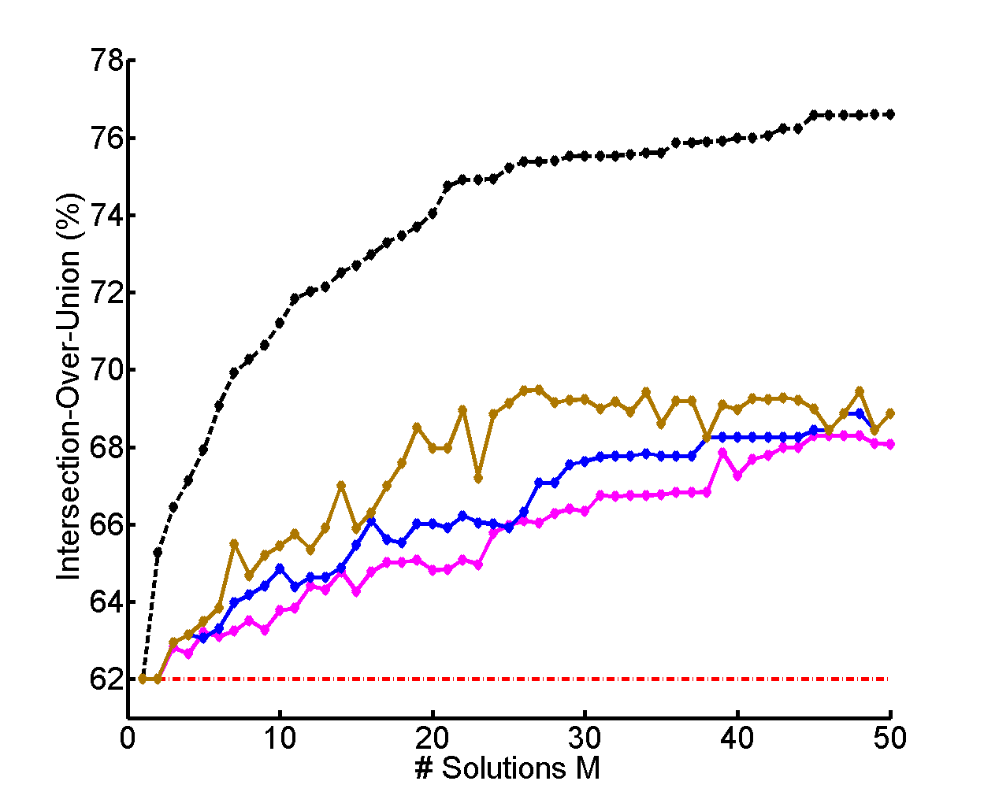
Interactive Binary Segmentation
~7% Gain
Same Model No new information!
MAP

Slide 29
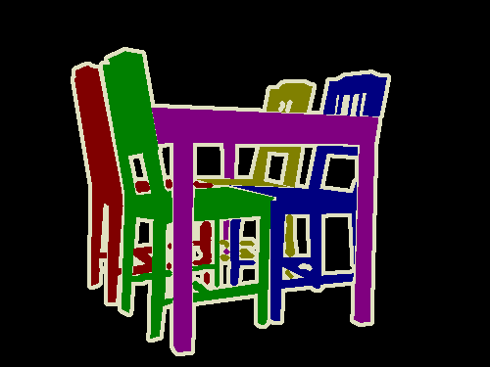
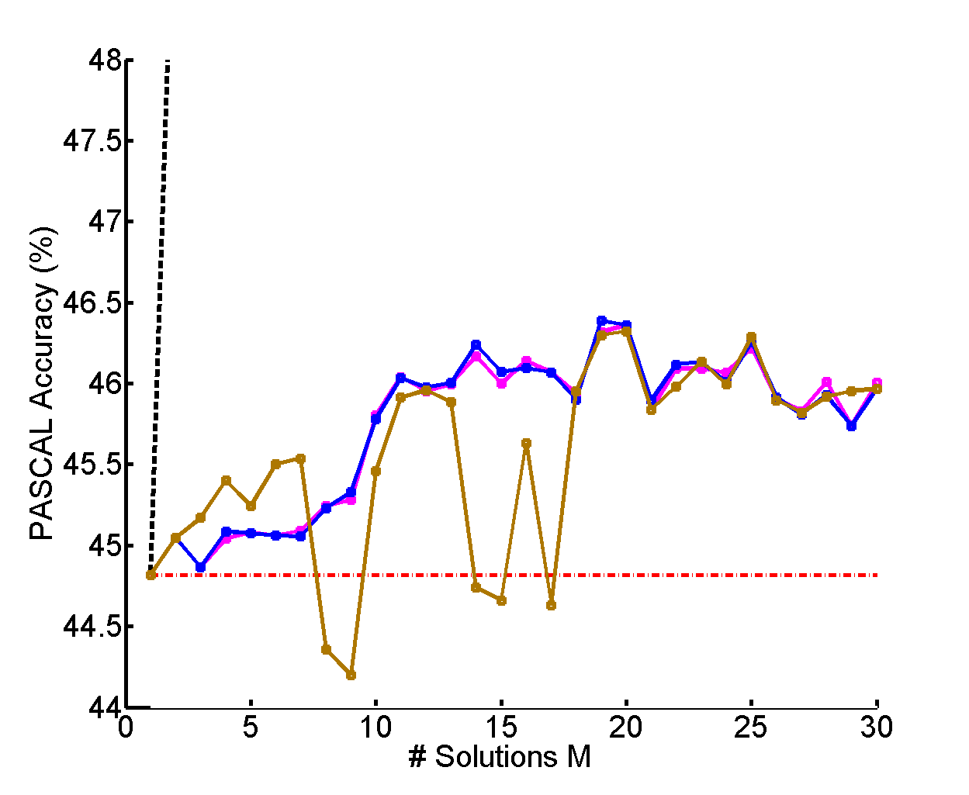
Semantic Segmentation
Setup
Model: CPMC+O2P
Inference: Greedy Pasting
Dataset: PASCAL VOC 2012 Val Set
Loss Function: Jaccard Index
~1.5% Gain
Same Model No new information!

Slide 30
Summary
All models are wrong!
MAP is not the answer to everything
Higher-order loss functions help
EMBR – Surprisingly effective meta-algorithm
Allows for the incorporation of higher-order loss functions

